Slide 1
Unit - V MICROWAVE SOLID STATE DEVICES & MEASUREMENTS
Presented by
V. Sai Anusha
MTech, Assistant Professor
AITS,Razampeta.

Slide 2
Introduction to TED’s
TED’s are bulk devices having no junctions or gates.
Fabricated from compound semiconductors like GaAs, InP or CdTe.
TED’s operate with “hot” electrons whose energy is very much greater than thermal energy.
Because of these fundamental differences, the theory and technology of transistors are not applied TED’s .

Slide 3
GUNN DIODE(GaAs)
vacuum form of diode, which is designed to operate in the range of microwave frequencies (from single GHz to single THz).
In 1963 John Battiscombe Gunn (J.B. Gunn) as a first person has observed that in the wafers of gallium arsenide with a very small thickness, after supplying them with a sufficiently large voltage, very high oscillation frequencies were generated.
Gunn diodes are used in high-frequency electronics as a source of great output power and high frequency.

Slide 4
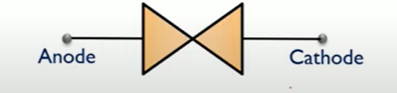
GUNN DIODE(GaAs)
It is a semiconductor device formed by only N type material.
Mainly GaAs, InP are the materials used for the fabrication of Gunn Diode.
Electrons are the majority charge carriers in N type material and these electrons are transferred from one valley to another.
By the means of transferred electron mechanism, it has negative resistance characteristic.

Slide 5
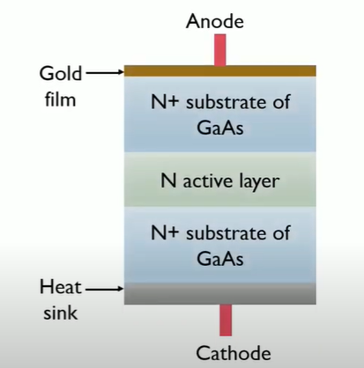
Construction of Gunn Diode
It is fabricated from only N type material. Thus it is not a PN junction device.
Gunn diode is 3 layer device in which a lightly doped N type semiconductor is placed between 2 highly doped N type material.

Slide 6
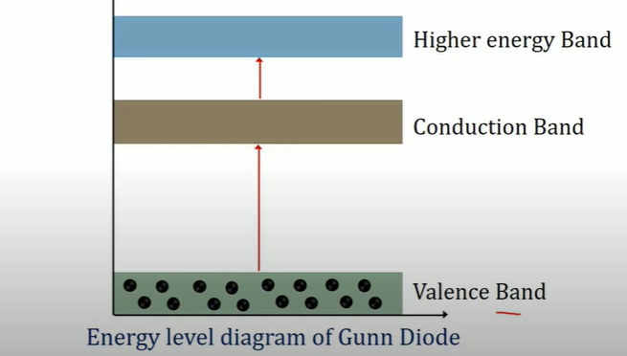
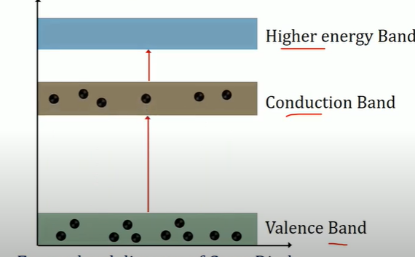
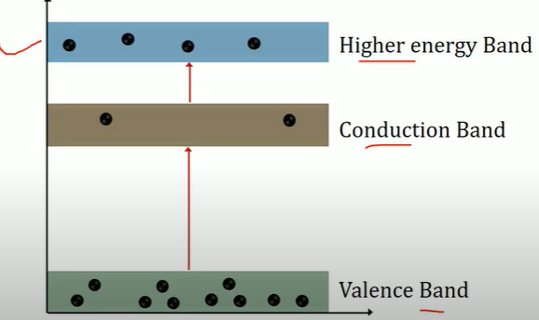
Gunn Diode -Working
Gunn effect is basis of working of a Gunn diode.
Gunn Effect can be defined as generation of microwave power whenever the voltage applied to a semiconductor device exceeds the critical voltage value or threshold voltage value.

Slide 7
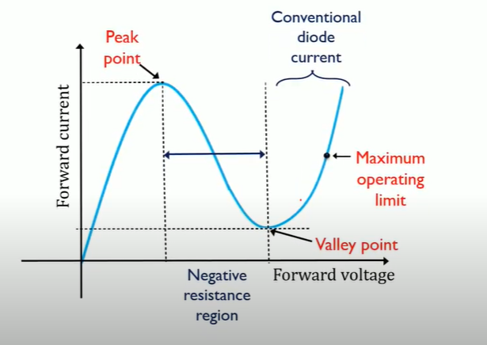
Gunn Diode –Characteristic Curve

Slide 8
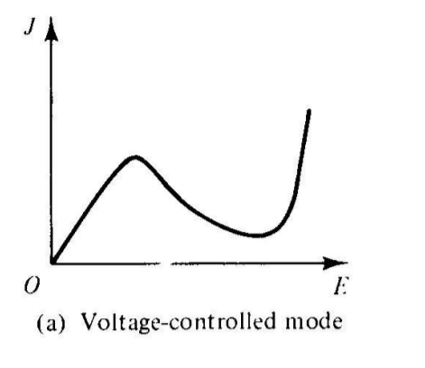
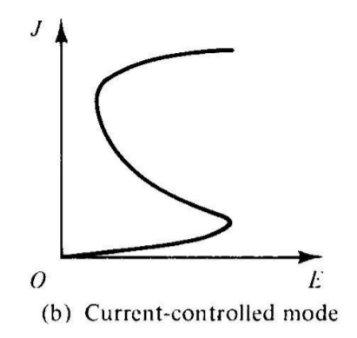
RWH THEORY - Differential Negative Resistance

Slide 9
RWH THEORY - Differential Negative Resistance
The fundamental concept of Ridley-Watkins-Hilsum theory is the differential negative resistance developed in a bulk solid state III-V compound when voltage or current is applied to the terminals of sample.
Two types of Negative Resistance devices :
Voltage controlled mode
Current Controlled mode

Slide 10
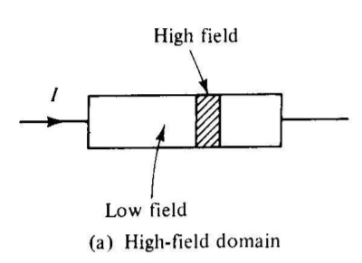
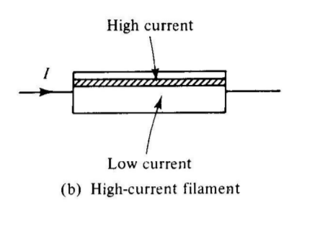
RWH THEORY - Differential Negative Resistance

Slide 11
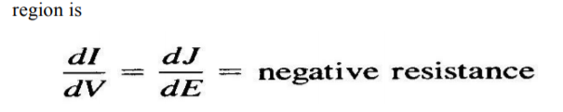
RWH THEORY - Differential Negative Resistance
In voltage controlled negative resistance mode, high field domains are formed, separating two low field regions.

Slide 12
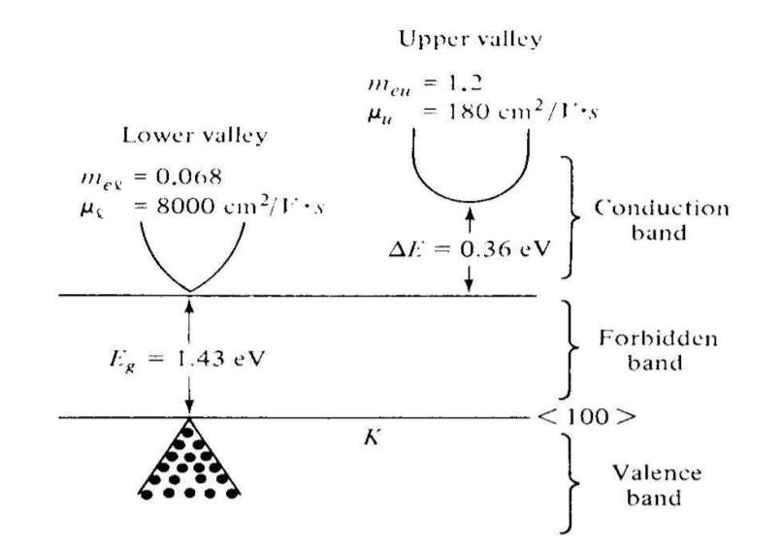
Two Valley Model Theory

Slide 13
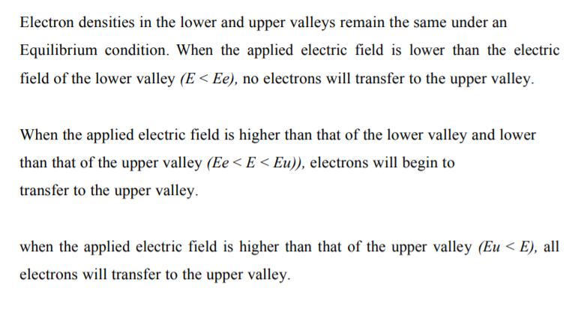
Two Valley Model Theory – Gunn diode

Slide 14
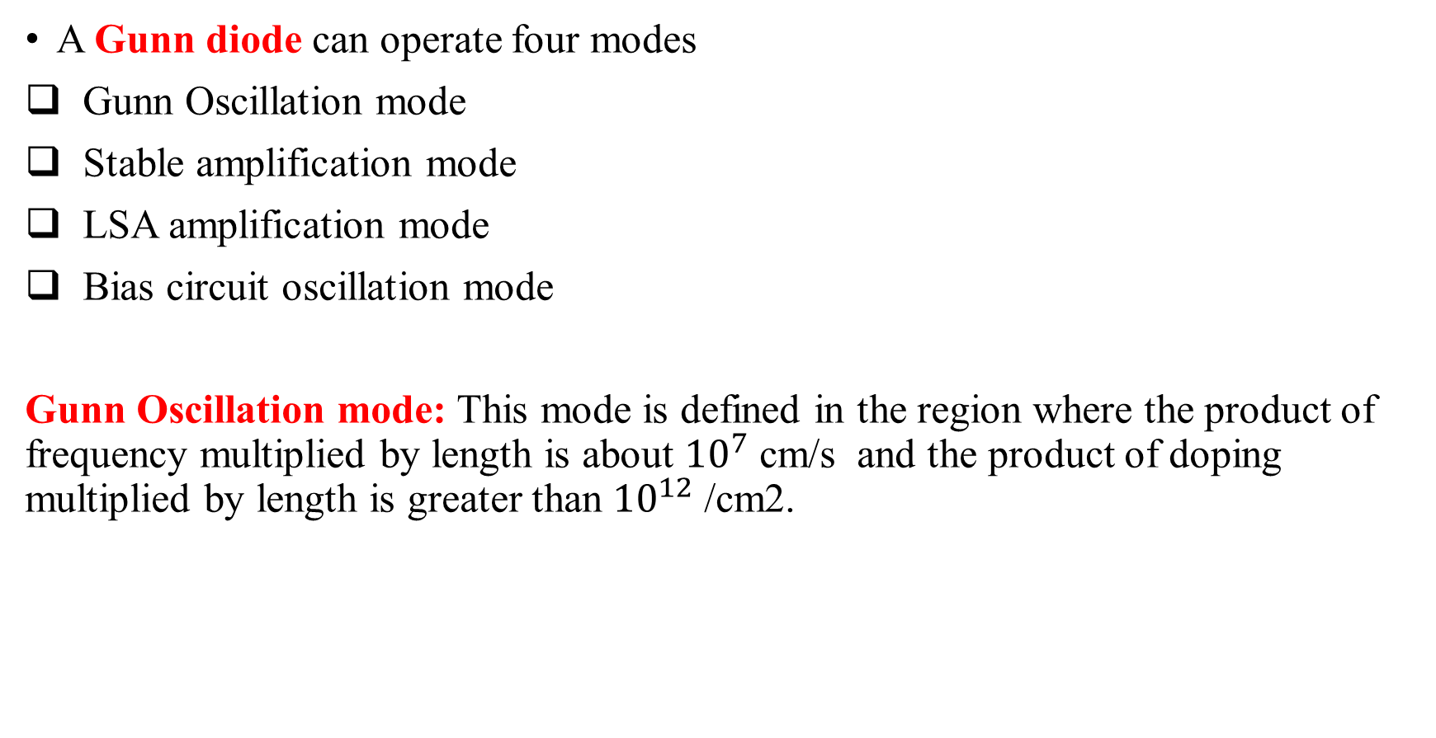
Modes of Operation of Gun diode
A Gunn diode can operate four modes
Gunn Oscillation mode
Stable amplification mode
LSA amplification mode
Bias circuit oscillation mode
Gunn Oscillation mode: This mode is defined in the region where the product of frequency multiplied by length is about ${10}^{7}$ cm/s and the product of doping multiplied by length is greater than ${10}^{12}$ /cm2.

Slide 15
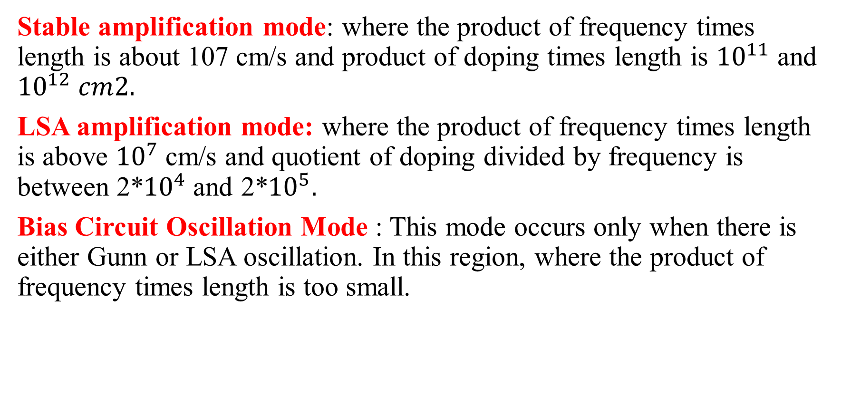
Modes of Operation of Gun diode
Stable amplification mode: where the product of frequency times length is about 107 cm/s and product of doping times length is ${10}^{11}$ and ${10}^{12} cm2.$
LSA amplification mode: where the product of frequency times length is above ${10}^{7}$cm/s and quotient of doping divided by frequency is between 2*${10}^{4}$and 2*${10}^{5}.$
Bias Circuit Oscillation Mode : This mode occurs only when there is either Gunn or LSA oscillation. In this region, where the product of frequency times length is too small.

Slide 16
Avalanche Transit Time
The process of having a delay between voltage and current, in avalanche together with transit time, through the material is said to be Negative resistance. The devices that helps to make a diode exhibit this property are called as Avalanche transit time devices.
Examples of the devices that come under this property are :
1. IMPATT is (IMPact ionization Avalanche Transit Time diode)
2.TRAPATT (TRApped Plasma Avalanche Triggered Transit diode)

Slide 17
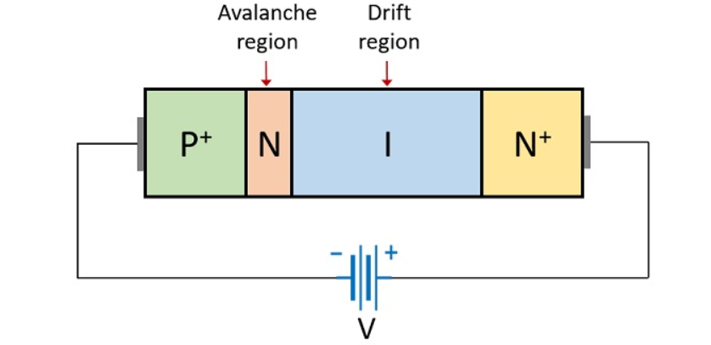
IMPATT
High-power semiconductor used in high frequency applications.
Typically made from silicon carbides due to their high breakdown fields.
Frequency – 3 to 100GHz.
High power capability.
Generate high level of phase noise.

Slide 18
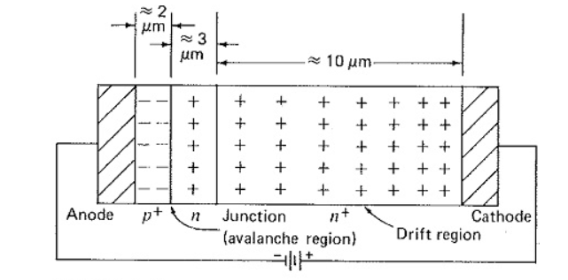
IMPATT - Schematic

Slide 19
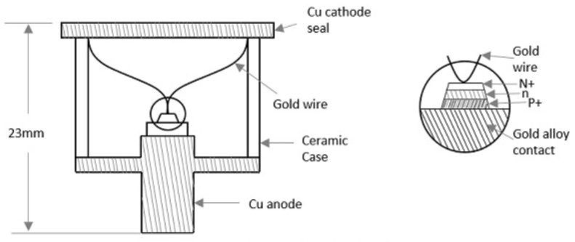
IMPATT – Construction Details

Slide 20
IMPATT – Construction Details
Application of a RF AC voltage if superimposed on a high DC voltage, the increased velocity of holes and electrons results in additional holes and electrons by thrashing them out of the crystal structure by Impact ionization.
If the original DC field applied was at the threshold of developing this situation, then it leads to the avalanche current multiplication and this process continues.
Due to this effect, the current pulse takes a phase shift of 90°. However, instead of being there, it moves towards cathode due to the reverse bias applied. The time taken for the pulse to reach cathode depends upon the thickness of n+ layer, which is adjusted to make it 90° phase shift. Now, a dynamic RF negative resistance is proved to exist. Hence, IMPATT diode acts both as an oscillator and an amplifier.

Slide 21
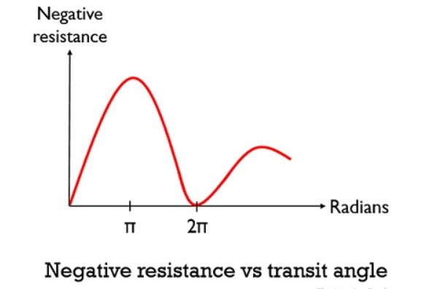
IMPATT – Negative Resistance Curve

Slide 22
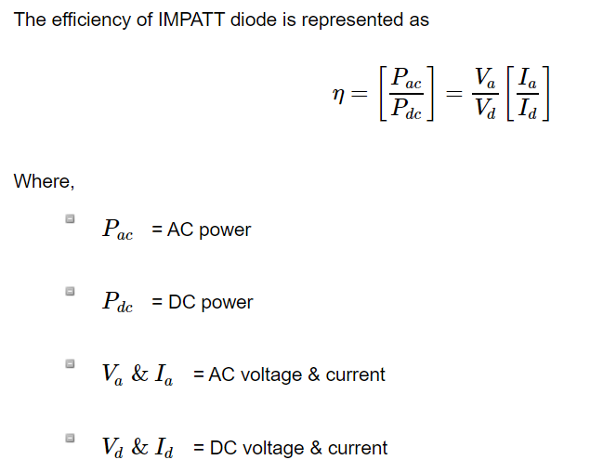
IMPATT

Slide 23
IMPATT – Advantages
High power capability
High levels of performance
Highly stable frequency

Slide 24
IMPATT – Performance Characteristics
Efficiency – 30%(Theoretical)
Frequency - 1 to 300GHz
Maximum output power for single diode – 4W
Several diodes combined – 40W

Slide 25
IMPATT – Applications
Microwave Oscillators
Negative resistance amplification
Modulated output oscillator
Receiver output oscillator

Slide 26
TRAPATT
Derived From the Trapped plasma Avalanche Triggered Transit.
A Microwave generator which operates between hundreds of MHz to GHz.
High peak power diodes usually n+- p-p+ or p+-n-n+ structures with n-type depletion region.
Frequency range – 0.5Ghz to 50Ghz.
Typically represented by a current pulse generator and the diode’s depletion layer capacitance.

Slide 27
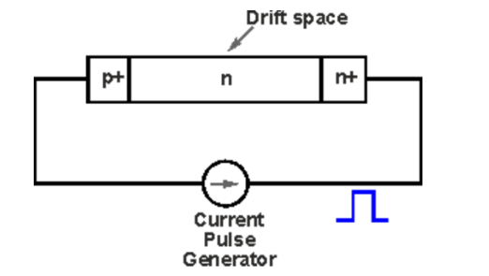
TRAPATT – STRUCTURE
Typically made of silicon with N type depletion region width = 2.5 to 12.5 micro.
P+ region = 2.5 to 7.5 micro m
Diode’s diameter range = 50 to 750 micro m

Slide 28
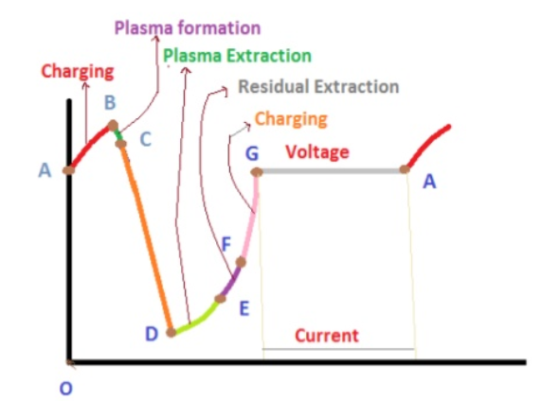
TRAPATT – Characteristic Curve

Slide 29
TRAPATT – OPERATION
TRAPATT is energized using a current pulse which roots the electric field to enhance to an important value where multiplication of avalanche occurs.
The partition and flow of the holes and electrons are driven by a very much minor field.
It almost shows that they have been ‘trapped’ behind with a velocity lesser than the velocity of saturation.
After the plasma increases across the entire active region, the electrons and holes start to drift to the reverse terminals and then the electric field starts to rise again.

Slide 30
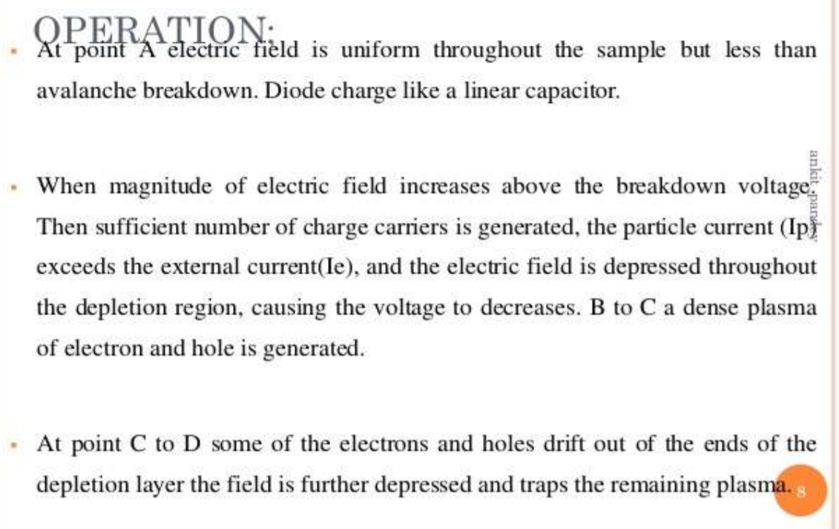
TRAPATT

Slide 31
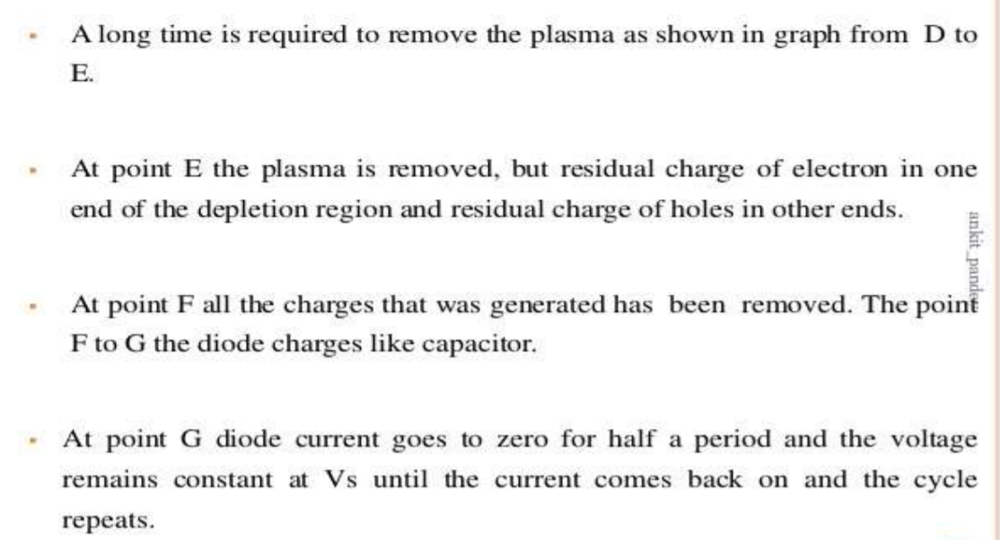
TRAPATT

Slide 32
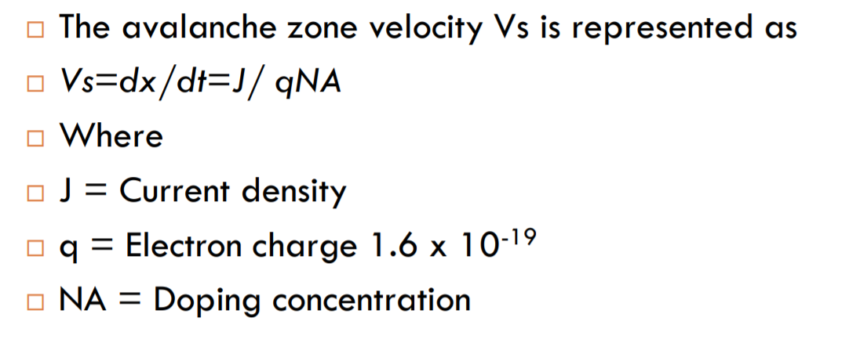
TRAPATT

Slide 33
TRAPATT – Advantages
More suitable for pulsed operation
15% to 40% efficiency is obtained
It can operate between 3 to 50GHz

Slide 34
TRAPATT –Applications
Low power Doppler radars or Local Oscillators for Radars
Landing systems
S-band pulsed transmitters for phase array radar system

Slide 35
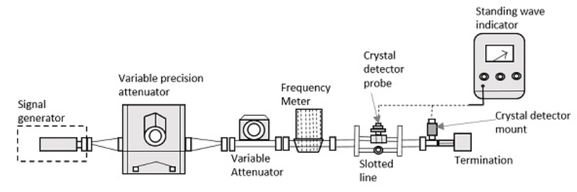
Microwave Bench Setup

Slide 36
Microwave Bench Setup
Signal Generator: As the name implies, it generates a microwave signal, in the order of a few milliwatts. This uses velocity modulation technique to transfer continuous wave beam into milliwatt power.
Example : A Gunn diode oscillator or a Reflex Klystron tube.
Precision Attenuator: This is the attenuator which selects the desired frequency and confines the output around 0 to 50db.
Variable Attenuator: This attenuator sets the amount of attenuation. It can be understood as a fine adjustment of values, where the readings are checked against the values of Precision Attenuator.

Slide 37
Microwave Bench Setup
Isolator : allows the signal to pass through the waveguide only in one direction.
Frequency meter: This is the device which measures the frequency of the signal. With this frequency meter, the signal can be adjusted to its resonance frequency.
Crystal Detector : A crystal detector probe and crystal detector mount are indicated , where the detector is connected through a probe to the mount. This is used to demodulate the signals.

Slide 38
Microwave Bench Setup
Standing Wave Indicator : The standing wave voltmeter provides the reading of standing wave ratio in dB. The waveguide is slotted by some gap to adjust the clock cycles of the signal. Signals transmitted by waveguide are forwarded through BNC cable to VSWR or CRO to measure its characteristics.
Slotted Line : In a microwave transmission line, the electromagnetic field is considered as the sum of incident wave from the generator and the reflected wave to the generator..
The standing waves obtained are measured to know the transmission line imperfections which is necessary to have a knowledge on impedance mismatch for effective transmission. This slotted line helps in measuring the standing wave ratio of a microwave device.

Slide 39
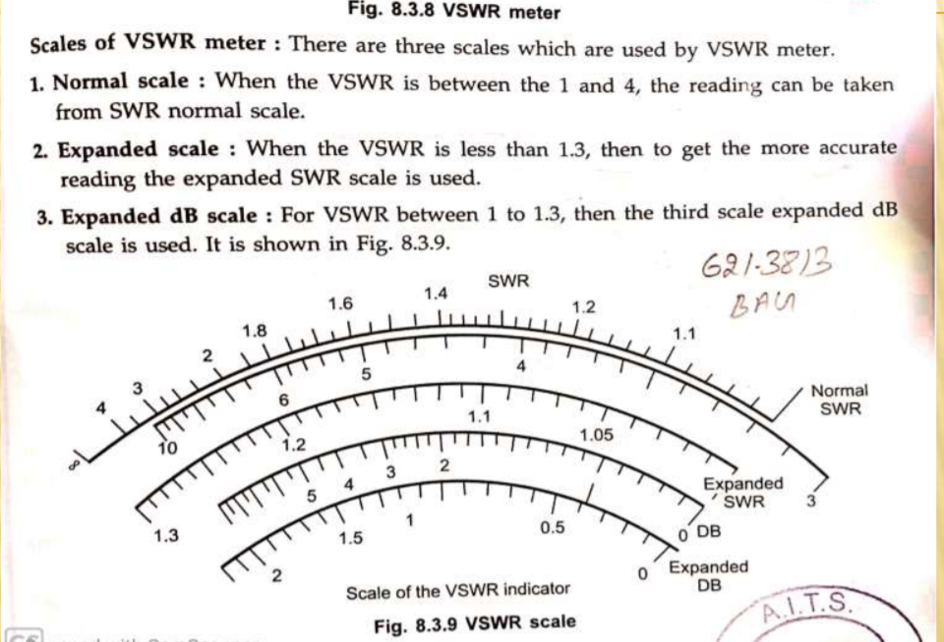
Microwave Bench Setup

Slide 40
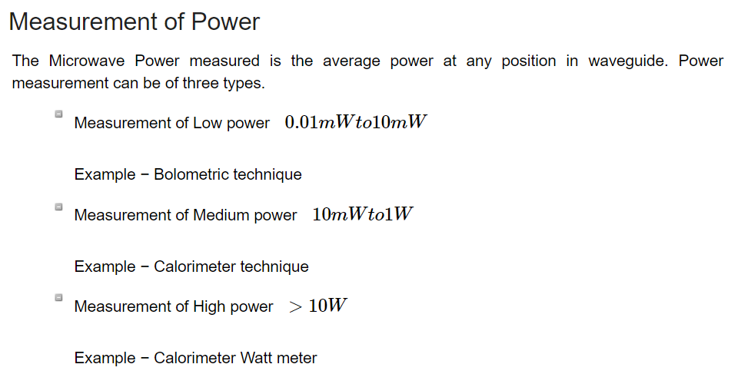
Microwave Power Measurement

Slide 41
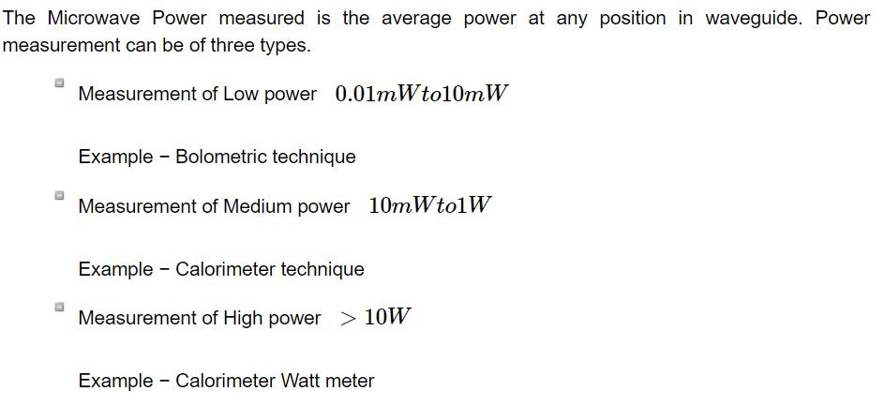
Microwave Power Measurement

Slide 42
Low Power Measurement
Bolometer is a device which is used for low Microwave power measurements. The element used in bolometer could be of positive or negative temperature coefficient. For example, a barrater has a positive temperature coefficient whose resistance increases with the increase in temperature. Thermistor has negative temperature coefficient whose resistance decreases with the increase in temperature.
Any of them can be used in the bolometer, but the change in resistance is proportional to Microwave power applied for measurement.

Slide 43
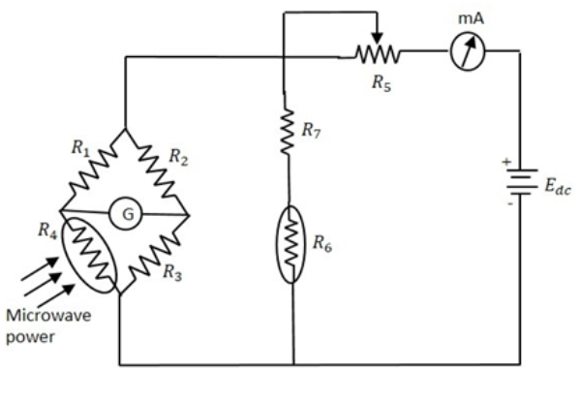
Low Power Measurement – Bolometer
The milli-ammeter here, gives the value of the current flowing. The battery is variable, which is varied to obtain balance, when an imbalance is caused by the behavior of the bolometer. This adjustment which is made in DC battery voltage is proportional to the Microwave power. The power handling capacity of this circuit is limited.

Slide 44
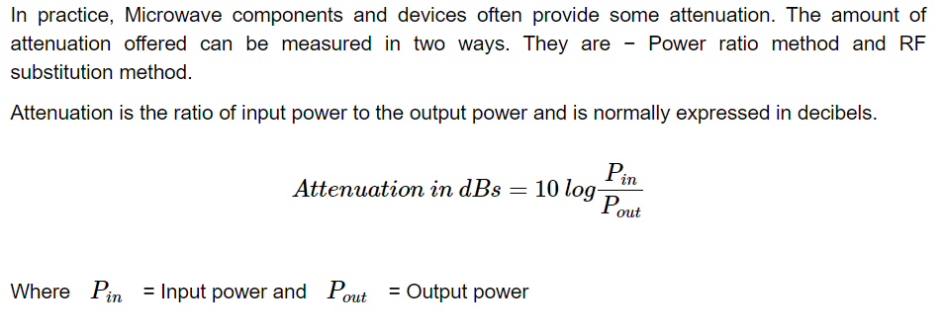
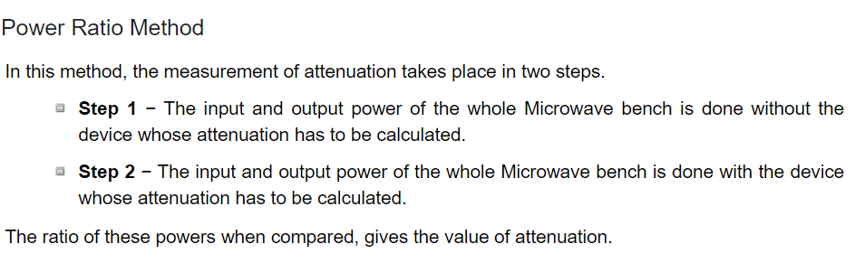
Measurement of Attenuation

Slide 45
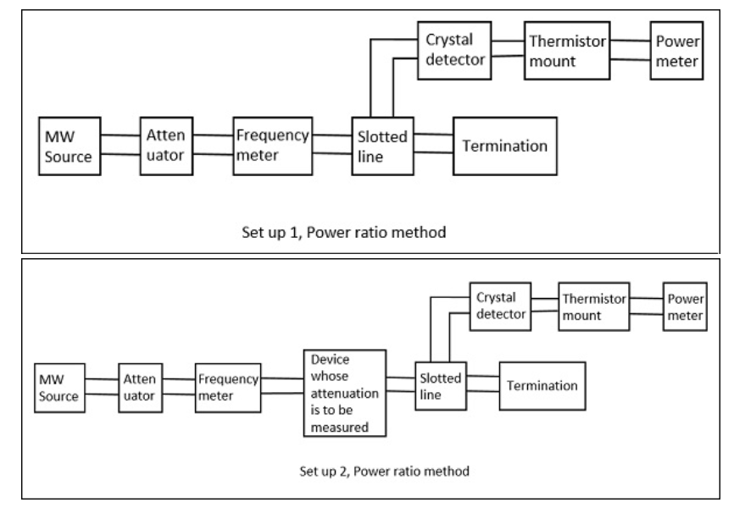
Measurement of Attenuation

Slide 46
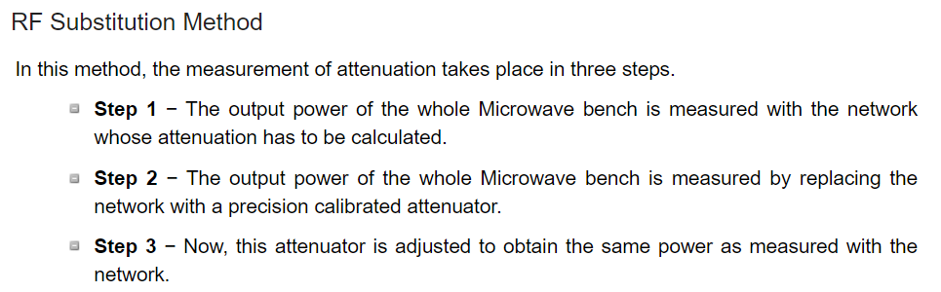
Measurement of Attenuation

Slide 47
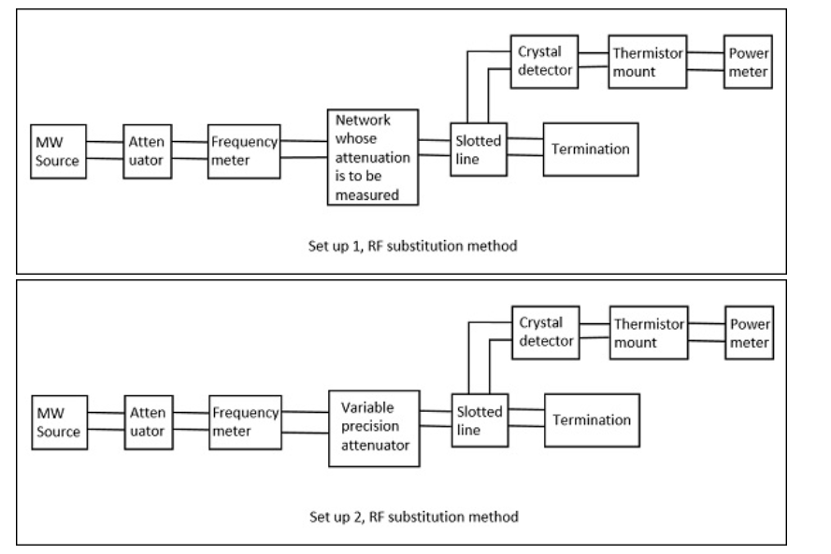
Measurement of Attenuation

Slide 48
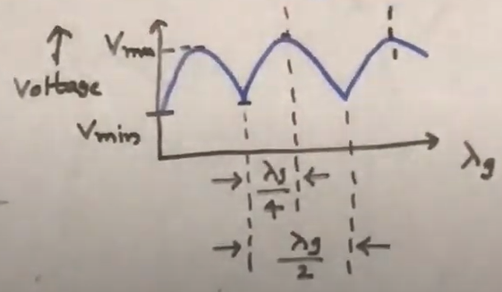
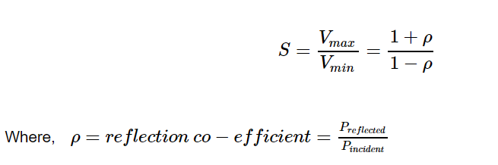
Measurement of VSWR
In any microwave practical applications, any kind of impedance mismatches lead to the formation of standing waves.
The strength of these standing waves is measured by Voltage Standing Wave Ratio.
The ratio of maximum to minimum voltage gives the VSWR, which is denoted by S.

Slide 49
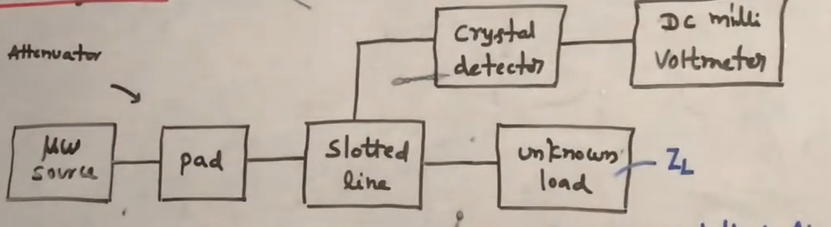
Measurement of VSWR
The Measurement of VSWR can be done in two ways, Low VSWR and high VSWR.
Measurement of Low VSWR S<10
The measurement of low VSWR can be done by adjusting the attenuator to get a reading on DC millivoltmeter.
The readings can be taken by adjusting the slotted line and the attenuator in such a way that the DC millivoltmeter shows a full scale reading as well as a minimum reading.
Now these two readings are calculated to find out the VSWR of the network.

Slide 50
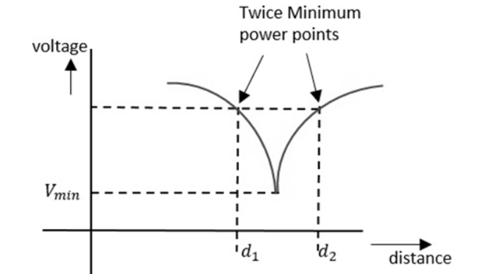
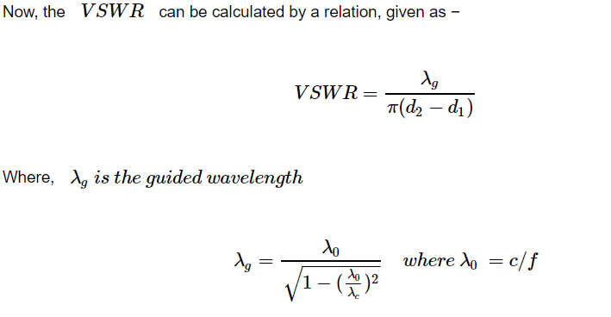
Measurement of VSWR
Measurement of High VSWR S>10
The measurement of high VSWR whose value is greater than 10 can be measured by a method called double minimum method.
In this method, the reading at the minimum value is taken and readings at the half point of minimum value in the crest before and crest after are also taken.

Slide 51

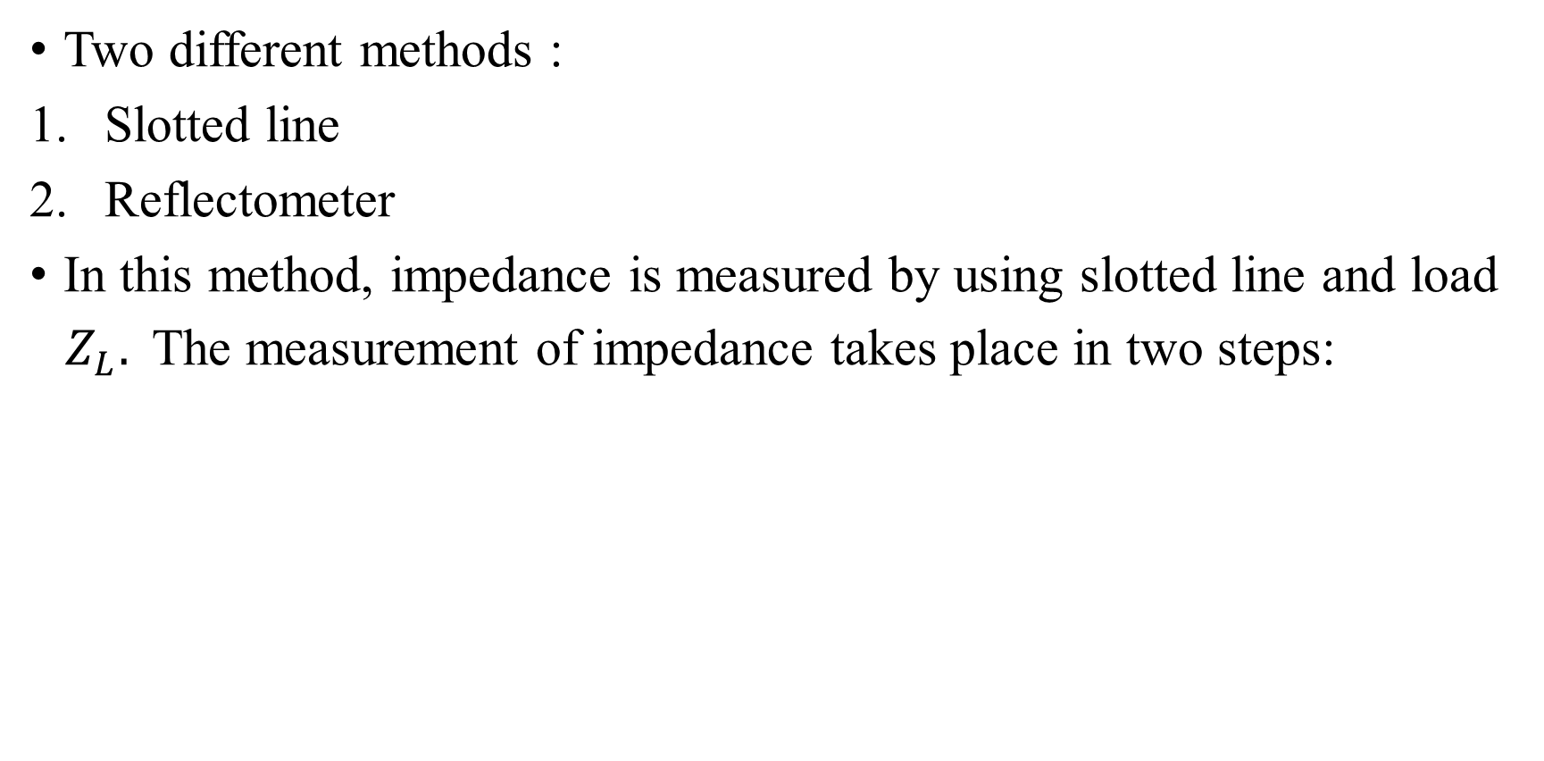
Measurement of Impedance
Two different methods :
Slotted line
Reflectometer
In this method, impedance is measured by using slotted line and load
$Z_{L}.$The measurement of impedance takes place in two steps:

Slide 52
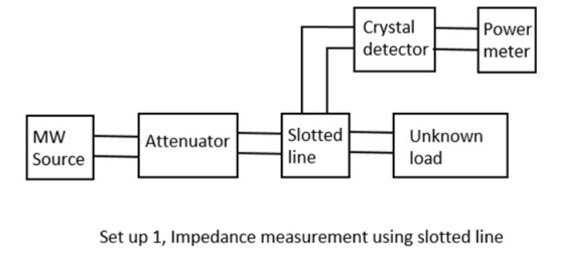
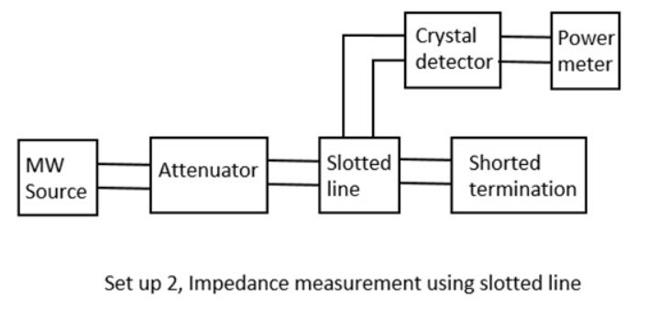
Measurement of Impedance by Slotted Line

Slide 53
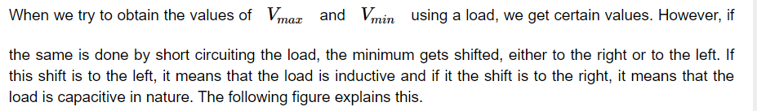
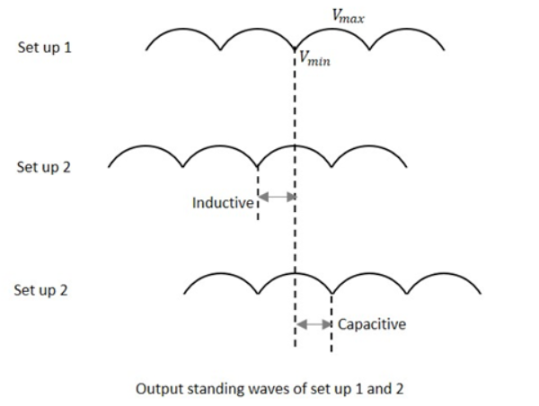
Measurement of Impedance by slotted line

Slide 54
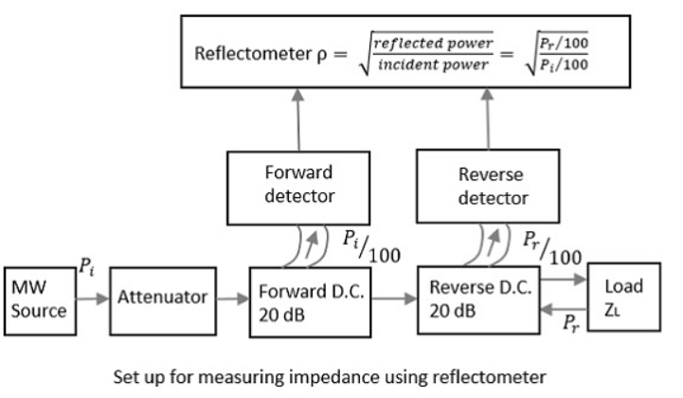
Measurement of Impedance by Reflectometer

Slide 55
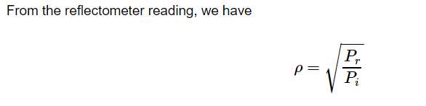
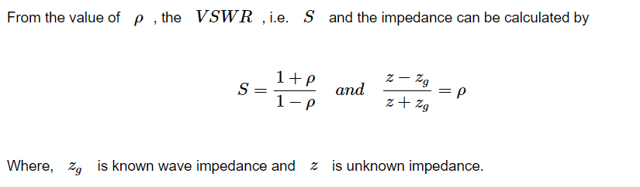
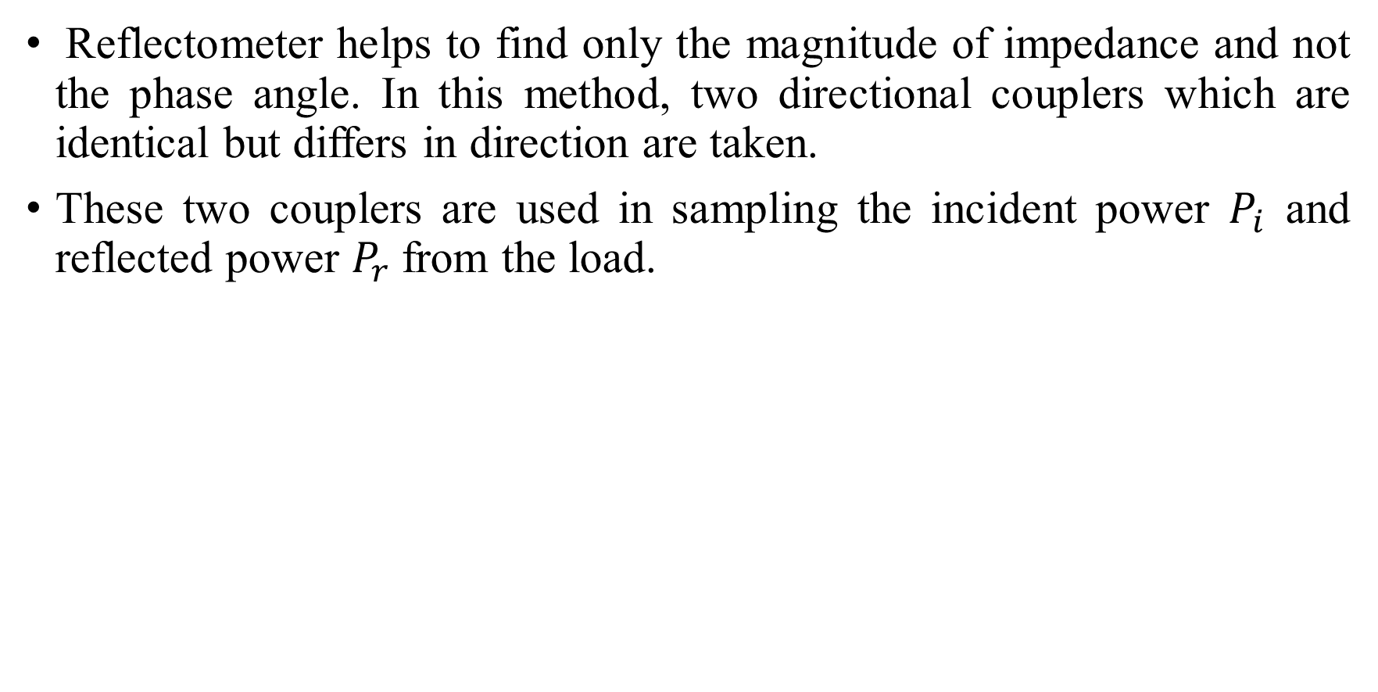
Measurement of Impedance by Reflectometer
Reflectometer helps to find only the magnitude of impedance and not the phase angle. In this method, two directional couplers which are identical but differs in direction are taken.
These two couplers are used in sampling the incident power $P_{i}$ and reflected power $P_{r}$from the load.

Slide 56
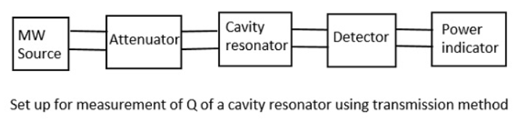

Measurement of Q of a Cavity Resonator

Slide 57

Measurement of Q of a Cavity Resonator

Slide 58

Measurement of Frequency
Microwave frequency can be measured by either electronic or mechanical techniques.

Slide 59
Prepare well for Exams!

